Slide 1
Voice Assistant using Speech Recognition
NATURAL LANGUAGE PROCESSING
Guide: Poonam Gadge

Slide 2
AGENDA
Introduction​
Literature survey
Problem Statement
​Methodology
Results
Conclusion

Slide 3
Introduction
Voice or speaker recognition is the ability of a machine or program to receive and interpret dictation or to understand and perform spoken commands. Voice recognition has gained prominence and use with the rise of artificial intelligence (AI) and intelligent assistants, such as Amazon's Alexa and Apple's Siri.
Voice recognition systems let consumers interact with technology simply by speaking to it, enabling hands-free requests, reminders and other simple tasks.

Slide 4
INTRODUCTION
Although voice recognition and speech recognition are referred to interchangeably, they aren't the same, and a critical distinction must be made.
Voice recognition identifies the speaker, whereas speech recognition evaluates what is said.

Slide 5
LITERATURE SURVEY
SR. No. | TOPIC | AUTHOR | DESCRIPTION
1 | Python Based AI Assistant for Computer | Shiv Prakash, Arpit Khare, Sudha Singh,Amisha Gangwar | It’s named as Python based AI Assistant for Computer which takes the user input in form of voice or text and process it and returns the output in various forms like action to be performed or the search result is dictated to the end user.
2 | Voice assistant using Python | Pooja C. Goutam, Monika S.Jalpure, Akshata S,Gavade, Pranjali Chaudhary, Prof.A.V Gundavade | IT is personal Desktop based voice assistant using Python which is built using open-source software PyCharm as an implementation tool.

Slide 6
PROBLEM STATEMENT
We are all well aware about Cortana, Siri, Google Assistant and many other virtual assistants which are designed to aid the tasks of users in Windows, Android and iOS platforms. But to our surprise, there’s no such complete virtual assistant available for Core Windows platform consisting of 70% of the users.
So, this is actually a major problem for users where there could be internet instability, server problems and places where internet is not accessible.

Slide 7
METHODOLOGY
Voice assistant applications work based on Automatic Speech Recognition (ASR) system. ASR systems record the speech and then break it down into phonemes, which are later get processed into text. A phoneme (not words of syllables) is a basic unit of measurement for human speech recognition.
Phoneme recognition delivers better results than the process of word decoding, as the last one tends to analyze word as a standalone unit ignoring the context
Acoustic modeling, which represents the which phonemes were pronounced and what are the words these phonemes complete;
Pronunciation modeling, that analyzes the way phonemes are pronounced, is there any accent or other peculiarities of the vocal apparatus to capture the phonetic variability of speech;
Language modeling, which is aimed at finding contextual probabilities depending on what phonemes were captured.

Slide 8
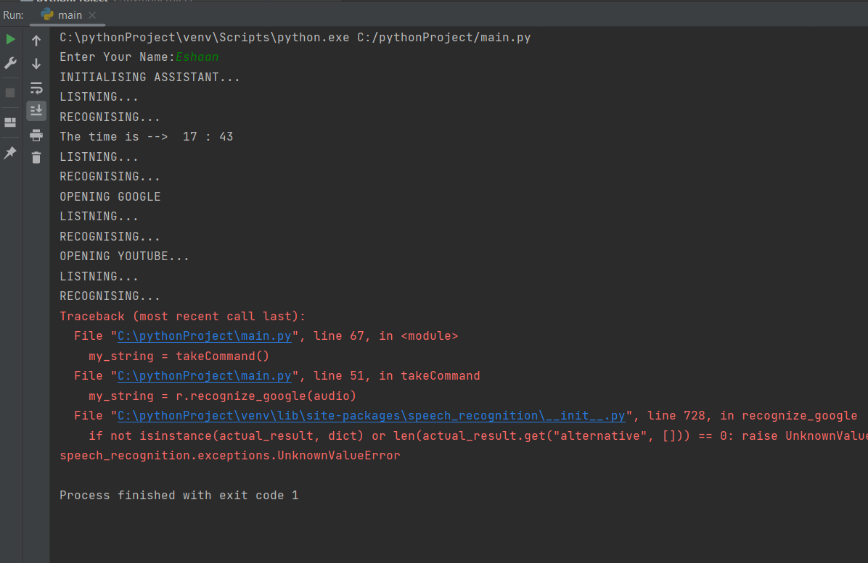
RESULTS

Slide 9


Slide 10
CONCLUSION
An excellent virtual assistant will save time and money by doing the small tasks for you and doing them accurately and with high quality. If you handle the virtual assistant correctly, it will be a boom in your business. If you’d like to find out more about hiring a virtual assistant, please consider someone from VP Virtual Assistants
The future of voice search and assistants is looking bright. With the number of people already seeing how convenient those tools can be and the growing number of devices that use voice recognition. It's clear that the technology will soon be everywhere, and with 5G and improvements in machine learning, voice assistants might at some point become tools we can’t live without.

